Slide 1
A Seminar on SmartQuiz: AI MCQ Generation
Team Details
Garlapati Akshay Reddy [20EG105314]
Lakshmishetty Nikhil Shetty [20EG105325]
Ramankol Srikanth [20EG105343]
Project Supervisor
P.Chakradhar
Assistant Professor

Slide 2
Introduction
Automated question generation is an innovative field within natural language processing (NLP) that leverages advanced machine learning techniques to automatically formulate questions from given textual content. This process involves understanding the context and extracting key information to generate meaningful and contextually relevant questions. To implement automated question generation, a combination of summarization, language modeling, and fine-tuning methodologies is typically employed.
To embark on automated question generation, certain prerequisites are essential. These include a comprehensive dataset for training and fine-tuning models, a robust NLP framework, and access to pre-trained language models capable of understanding and processing contextual information. Additionally, an understanding of the target domain and the specific requirements for generating questions is crucial for effective implementation.

Slide 3
Introduction
The applications of automated question generation are diverse and impactful.
Education:
Automated question generation for educational materials.
Efficient creation of quizzes and exams for various subjects and levels.
Adaptive learning platforms for personalized assessments.
Training and Evaluation:
Enhancing the efficiency of training programs by automating the creation of evaluation materials.
Providing a tool for organizations to assess the knowledge and understanding of their workforce.

Slide 4
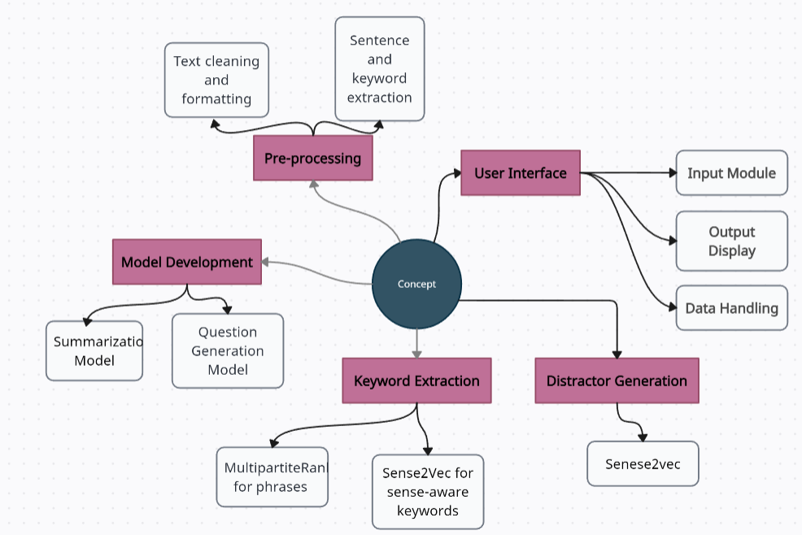
Concept Tree
SmartMCQ
SmartMCQ

Slide 5
Literature
Sl.No | Strategies | Advantages | Disadvantages
1 | Rule-based with Named Entity Recognition | Automatic question generation, NER for answer identification | Limited flexibility, rule complexity.
2 | Focus generator module, Neural Entity Selection Algorithm, Recurrent Neural Networks | Diverse question types, SQuAD dataset utilization | Computational complexity, training data dependency.
3 | Wikipedia-based dataset, Paradigmatic Relation discovery | Wide knowledge base utilization, Intelligent Tutoring Systems | Limited subject matter scope, dependence on pre-existing data.
4 | Semantics and Service Technologies | Heuristics for distractor suitability, Semantic Trees | Dependency on semantic tree quality, complexity.
5 | Semantic Similarity, Syntactic Similarity, Context-fit | Incorporates semantic and syntactic information, Word2Vec | Sensitivity to context, Word2Vec training dependency.

Slide 6
Literature(cont..)
Sl.No | Author | Strategies | Advantages | Disadvantages
1 | Min-Kyoung Kim et al. [1] | Rule-based with Named Entity Recognition | Automatic QA generation, Named Entity Recognition | Limited flexibility, rule complexity
2 | Sushmita Gangopadhyay et al. [2] | Focus generator, Neural Entity Selection, RNN | Diverse question types, SQuAD dataset utilization | Computational complexity, training data dependency
3 | Riken Shah et al. [3] | Wikipedia-based dataset, Paradigmatic Relation discovery | Knowledge base utilization, Intelligent Tutoring Systems | Limited subject matter scope, dependence on pre-existing data
4 | Pedro Álvarez et al. [4] | Semantics and Service Technologies | Diverse distractors, Semantic Trees utilization | Dependency on semantic tree quality, complexity.
5 | Bowei Zou et al. [7] | Unsupervised domain-independent true/false question generation | Domain-independent, Masking-and-infilling strategy | Limited to true/false questions, masking strategy sensitivity

Slide 7
Problem Statement
The project aims to enhance the efficiency of content summarization, keyword extraction, question generation, and distractor generation through the integration of advanced natural language processing techniques. By employing state-of-the-art models and algorithms, the system streamlines the information extraction process, facilitating better comprehension and utilization of textual content.
Current approaches lack precision, struggle with diverse content, and may produce suboptimal results. The project addresses these issues by employing modern NLP models for improved language understanding.
The project tackles information overload, aiming to provide accurate and concise content summaries, relevant keywords, and meaningful questions. It addresses the limitations of conventional methods in handling the increasing volume of textual data.

Slide 8
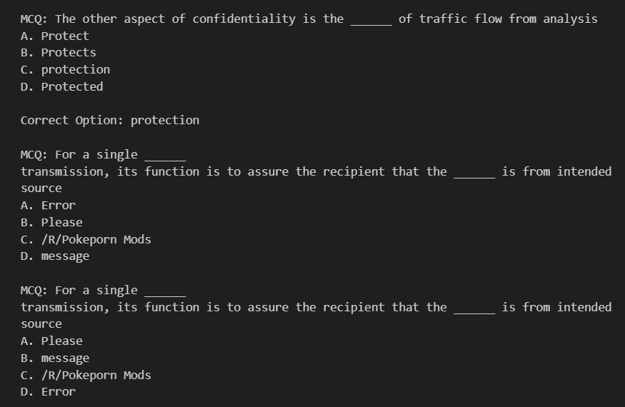
Problem Illustration

Slide 9
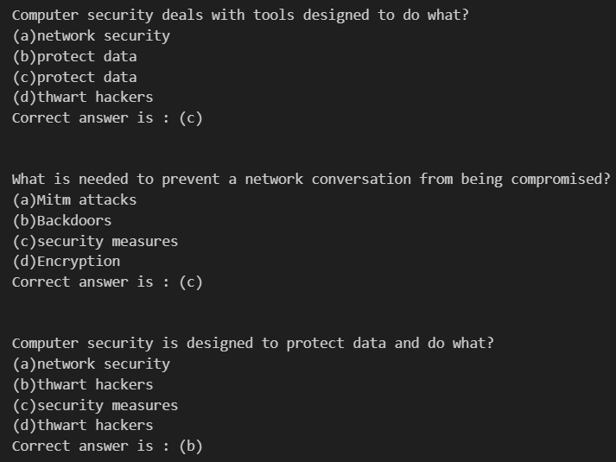

Slide 10
Proposed Method
Text Summarization:
Perform summarization on the given text to condense the information and capture key points.
Keyword Extraction:
Utilize keyword extraction methods (e.g., YAKE, TopicRank, KeyBERT) to identify important terms or phrases from the processed text.
Question Generation:
Generate questions based on the extracted keywords by using a fine-tuned question generation model (T5 model trained on Squad-V1 dataset and computer dataset).
Formulate questions in a context-answer format, incorporating the keywords and relevant information from the processed text.

Slide 11
Distractor Generation:
Generate distractors (wrong answer choices) using method like Sense2Vec and finding sense of it.
Using MMR (Maximal Marginal Relevance) to get diverse distractors
Ensure that distractors are contextually relevant but distinct from the correct answer.
Display Results:
Present the generated questions along with answer choices (including the correct answer and distractors) for assessment.

Slide 12
Parameters Improved
Summarization Model:
The BertSUM summarization model is used and can be fine-tuned for better performance on specific domains or datasets.
Question Generation Model:
The T5-based question generation model is fine-tuned on Squad-V1 dataset to improve its accuracy and relevance for the task and fine-tuned again using our new dataset.
Parameter Tuning for Distractors:
Parameters such as the number of top similar words (top_n) and lambda_param (used in MMR algorithm) are fine-tuned for better distractor generation.

Slide 13
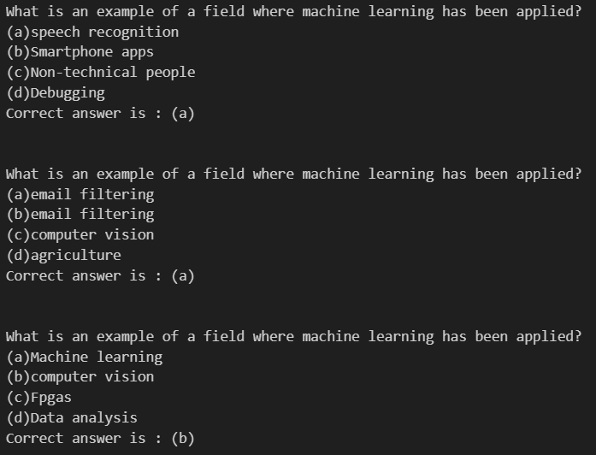
Proposed Method Illustration
Text input:
Machine learning approaches have been applied to many fields including large language models, computer vision, speech recognition, email filtering, agriculture, and medicine, where it is too costly to develop algorithms to perform the needed tasks.^{[4][5]} ML is known in its application across business problems under the name predictive analytics. Although not all machine learning is statistically based, computational statistics is an important source of the field's methods.

Slide 14
Parameter
Formulas for Parameter, calculate values by sample values in Proposed Method Illustration

Slide 15
Experiment Environment
Tool, language, data set … etc
Programming Languages:
Backend:
Python (Flask for web development)
Frontend :
HTML, CSS, JavaScript
NLP and ML:
Python (using libraries like SpaCy, NLTK, etc.)
Datasets: SQUAD

Slide 16
Project status
S.No | Functionality | Status (Completed /in-progress/Not started)
1 | Abstract | Completed
2 | Literature Survey | Completed
3 | Proposed method | Completed
4 | Developing dataset | In-progress

Slide 17
References
1] Min-Kyoung Kim, Han-Joon Kim, “Design of Question Answering System with Automated Question Generation”, 2008 IEEE 28th International Symposium on Computer-Based Medical Systems.
[2] Susmita Gangopadhyay, Ravikiran S.M, “Focused Questions and Answer Generation by Key Content Selection”, 2020 IEEE Sixth International Conference on Multimedia Big Data (BigMM)
[3] Riken Shah, Deesha Shah, Prof. Lakshmi Kurup, “Automatic Question Generation for Intelligent Tutoring Systems”, 2017 2nd International Conference on Communication Systems, Computing and IT Applications (CSCITA)
[4] Pedro Álvarez, Sandra Baldassarri, “Semantics and service technologies for the automatic generation of online MCQ tests”, 2018 IEEE Global Engineering Education Conference (EDUCON)
[5] Girish Kumar, Rafael E. Banchs, Luis Fernando D’Haro, “Automatic Fill-the-blank Question Generator for Student Self-assessment”, 2015 IEEE Frontiers in Education Conference (FIE)
[6] A. Hadifar, S. K. Bitew, J. Deleu, C. Develder and T. Demeester, "EduQG: A Multi-Format Multiple-Choice Dataset for the Educational Domain," in IEEE Access
[7] Bowei Zou, Pengfei Li, Liangming Pan, Ai Ti Aw, “Automatic True/False Question Generation for Educational Purpose”, 17th Workshop on Innovative Use of NLP for Building Educational Applications (BEA 2022)

Slide 18
Thank you

Slide 19
Project seminar–I Evaluation
S.No | Rubrics | Marks
1 | Concept Introduction | 4
2 | Literature and Parameter | 5
3 | Problem and Problem Illustration | 8
4 | Proposed Method and Illustration | 8
Total |  | 25

